Slide 1
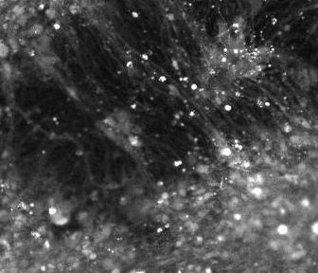
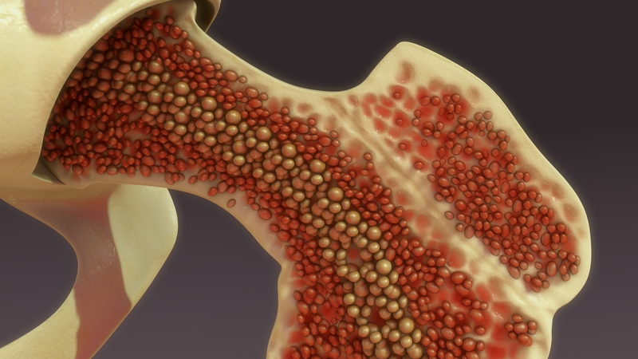
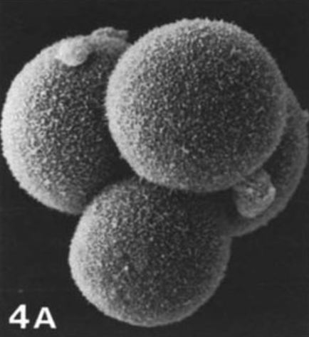
Brain organoid
Brain organoid made from stem cells
Adult stem cells in bone marrow
bone marrow
What is the connection?
Mini beating heart
Mini beating heart made from stem cells
Answer:
Stem cells
Human embryo
Human embryo stem cells

Slide 2
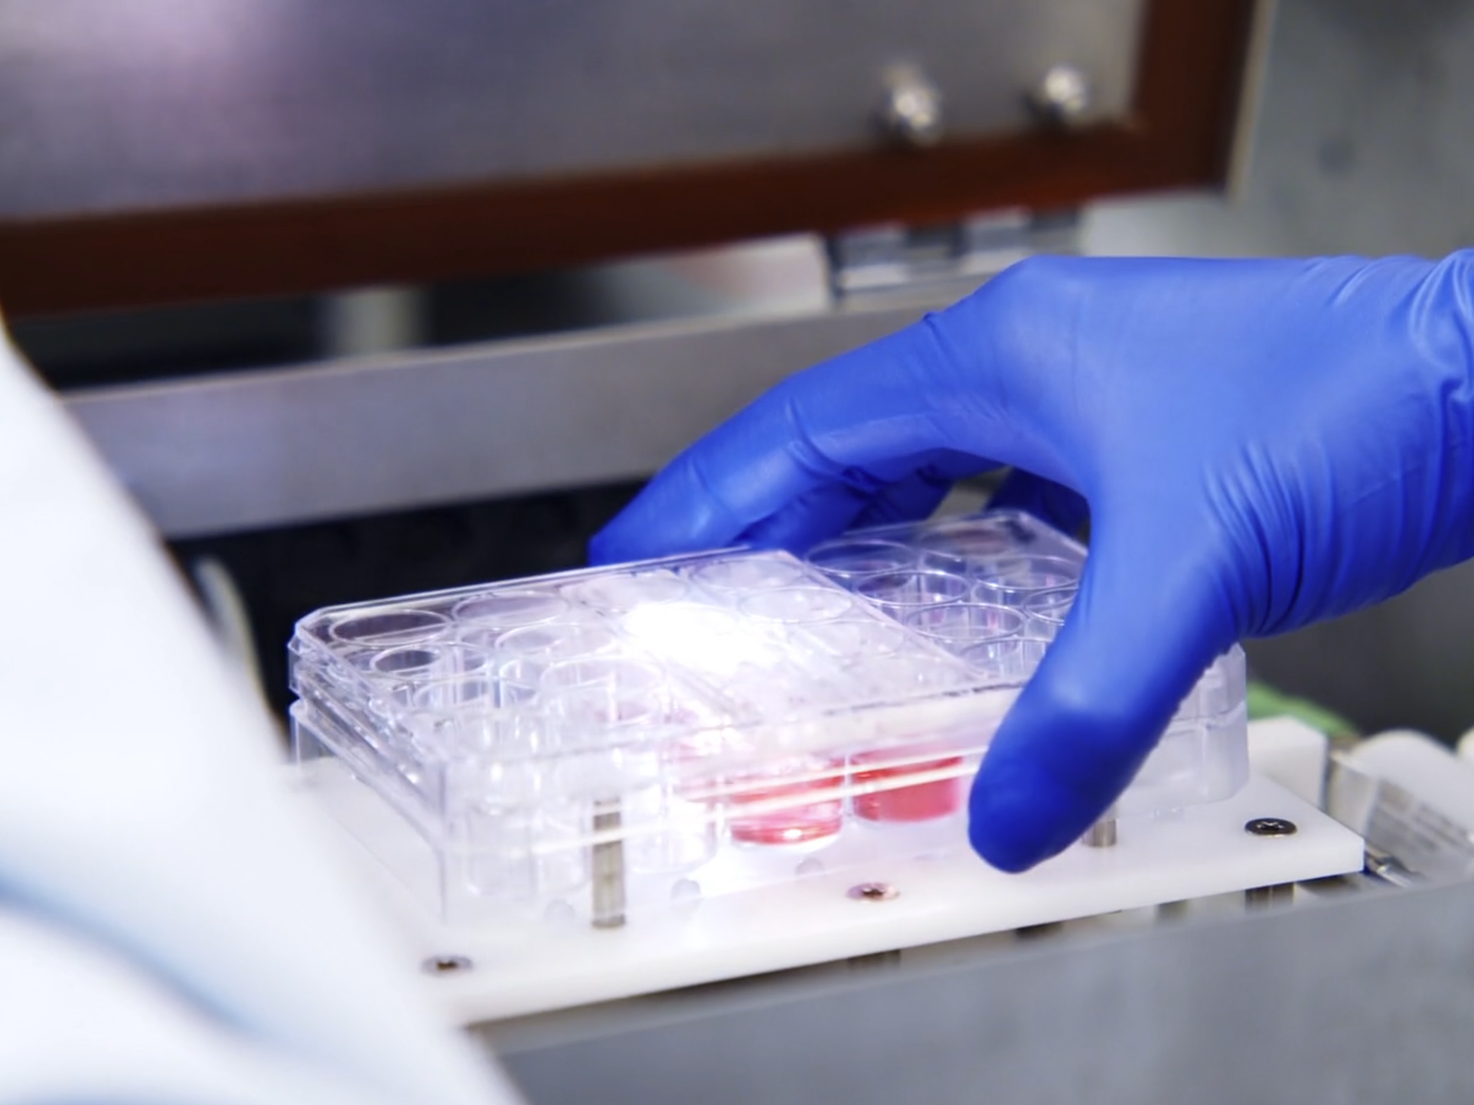
Stem cells in medicine
How are different types of stem cells used in medicine?
What are the clinical, ethical and social issues associated with stem cells?

Slide 3
How to mend a broken heart
Notes:
https://youtu.be/uIacgUjJVjo

Slide 4
Creating mini brains
Notes:
https://youtu.be/WJgzVgLLH1g

Slide 5
Add the labels to the correct place in the stem cell types diagram
Stem cell types
Labels
Reprogramming
Can differentiate to become many cells
Specialised cells
Induced pluripotent stem cells
Cannot differentiate
Embryonic stem cells
Can differentiate to become a few cells
Adult stem cells
Notes:
Can be printed and cut out

Slide 6
Answers
Stem cell types
Induced pluripotent stem cells
Reprogramming
Embryonic stem cells
Adult stem cells
Specialised cells
Can differentiate to become many cells
Can differentiate to become a few cells
Cannot differentiate
Notes:
Can be printed and cut out

Slide 8
 | Embryonic | Adult | Induced pluripotent
Where do the cells come from?
What can they do?
What could they be used for?
What are the problems?
Notes:
BLANK

Slide 9
 | Embryonic | Adult | Induced pluripotent
Where do the cells come from? | Discarded _________ from IVF treatment | _________ marrow | Almost any _________ in the body
What can they do? | Can _________ into any cell in the body | They are multipotent - can differentiate into a ____ number of cells | Unipotent cells are _________ to become pluripotent
What could they be used for? | To treat _________ by replacing damaged cells in the pancreas | Bone marrow _________ for people with cancer | Disease research and _________ development
What are the problems? | Ethical issues: Embryo is _________during process | Risk of _________ | Cells in a dish may not behave exactly as they do in a _________
Word bank: diabetes, drug, body, bone, cell, limited, reprogrammed, embryos, transplants, differentiate, destroyed, infection
Notes:
CLOZE

Slide 10
 | Embryonic | Adult | Induced pluripotent
Where do the cells come from? | Discarded e_________ from IVF treatment | B_________ marrow | Almost any c_________ in the body
What can they do? | Can d_________ into any cell in the body | They are multipotent - can differentiate into a l____ number of cells | Unipotent cells are r_________ to become pluripotent
What could they be used for? | To treat d_________ by replacing damaged cells in the pancreas | Bone marrow t_________ for people with cancer | Disease research and d_________ development
What are the problems? | Ethical issues: Embryo is d_________during process | Risk of i_________ | Cells in a dish may not behave exactly as they do in a b_________
Word bank: diabetes, drug, body, bone, cell, limited, reprogrammed, embryos, transplants, differentiate, destroyed, infection
Notes:
CLOZE with support

Slide 11
 | Embryonic | Adult | Induced pluripotent
Where do the cells come from? | Discarded embryos from IVF treatment | Bone marrow | Almost any cell in the body
What can they do? | Can differentiate into any cell in the body | They are multipotent - can differentiate into a limited number of cells | Unipotent cells are reprogrammed to become pluripotent
What could they be used for? | To treat diabetes by replacing damaged cells in the pancreas | Bone marrow transplants for people with cancer | Disease research and drug development
What are the problems? | Ethical issues: Embryo is destroyed during process | Risk of infection | Cells in a dish may not behave exactly as they do in a body
Notes:
Answers

Slide 12
Can differentiate into limited number of cell types
Embryonic stem cells
Can be taken from most parts of the body
Research is conducted on sentient beings
Can differentiate into any type of cell
Uses cells taken from IVF treatment
Can differentiate
Extension: add some of your own
Adult stem cells
Induced pluripotent stem cells
Notes:
To print

Slide 13
Can differentiate into limited number of cell types
Embryonic stem cells
Can be taken from most parts of the body
Research is conducted on sentient beings
Research is conducted on sentient beings
Can differentiate into any type of cell
Uses cells taken from IVF treatment
Uses cells taken from IVF treatment
Can differentiate
Can differentiate into any type of cell
Extension: add some of your own
Can differentiate
Can differentiate into limited number of cell types
Can be taken from most parts of the body
Adult stem cells
Induced pluripotent stem cells

