Slide 1
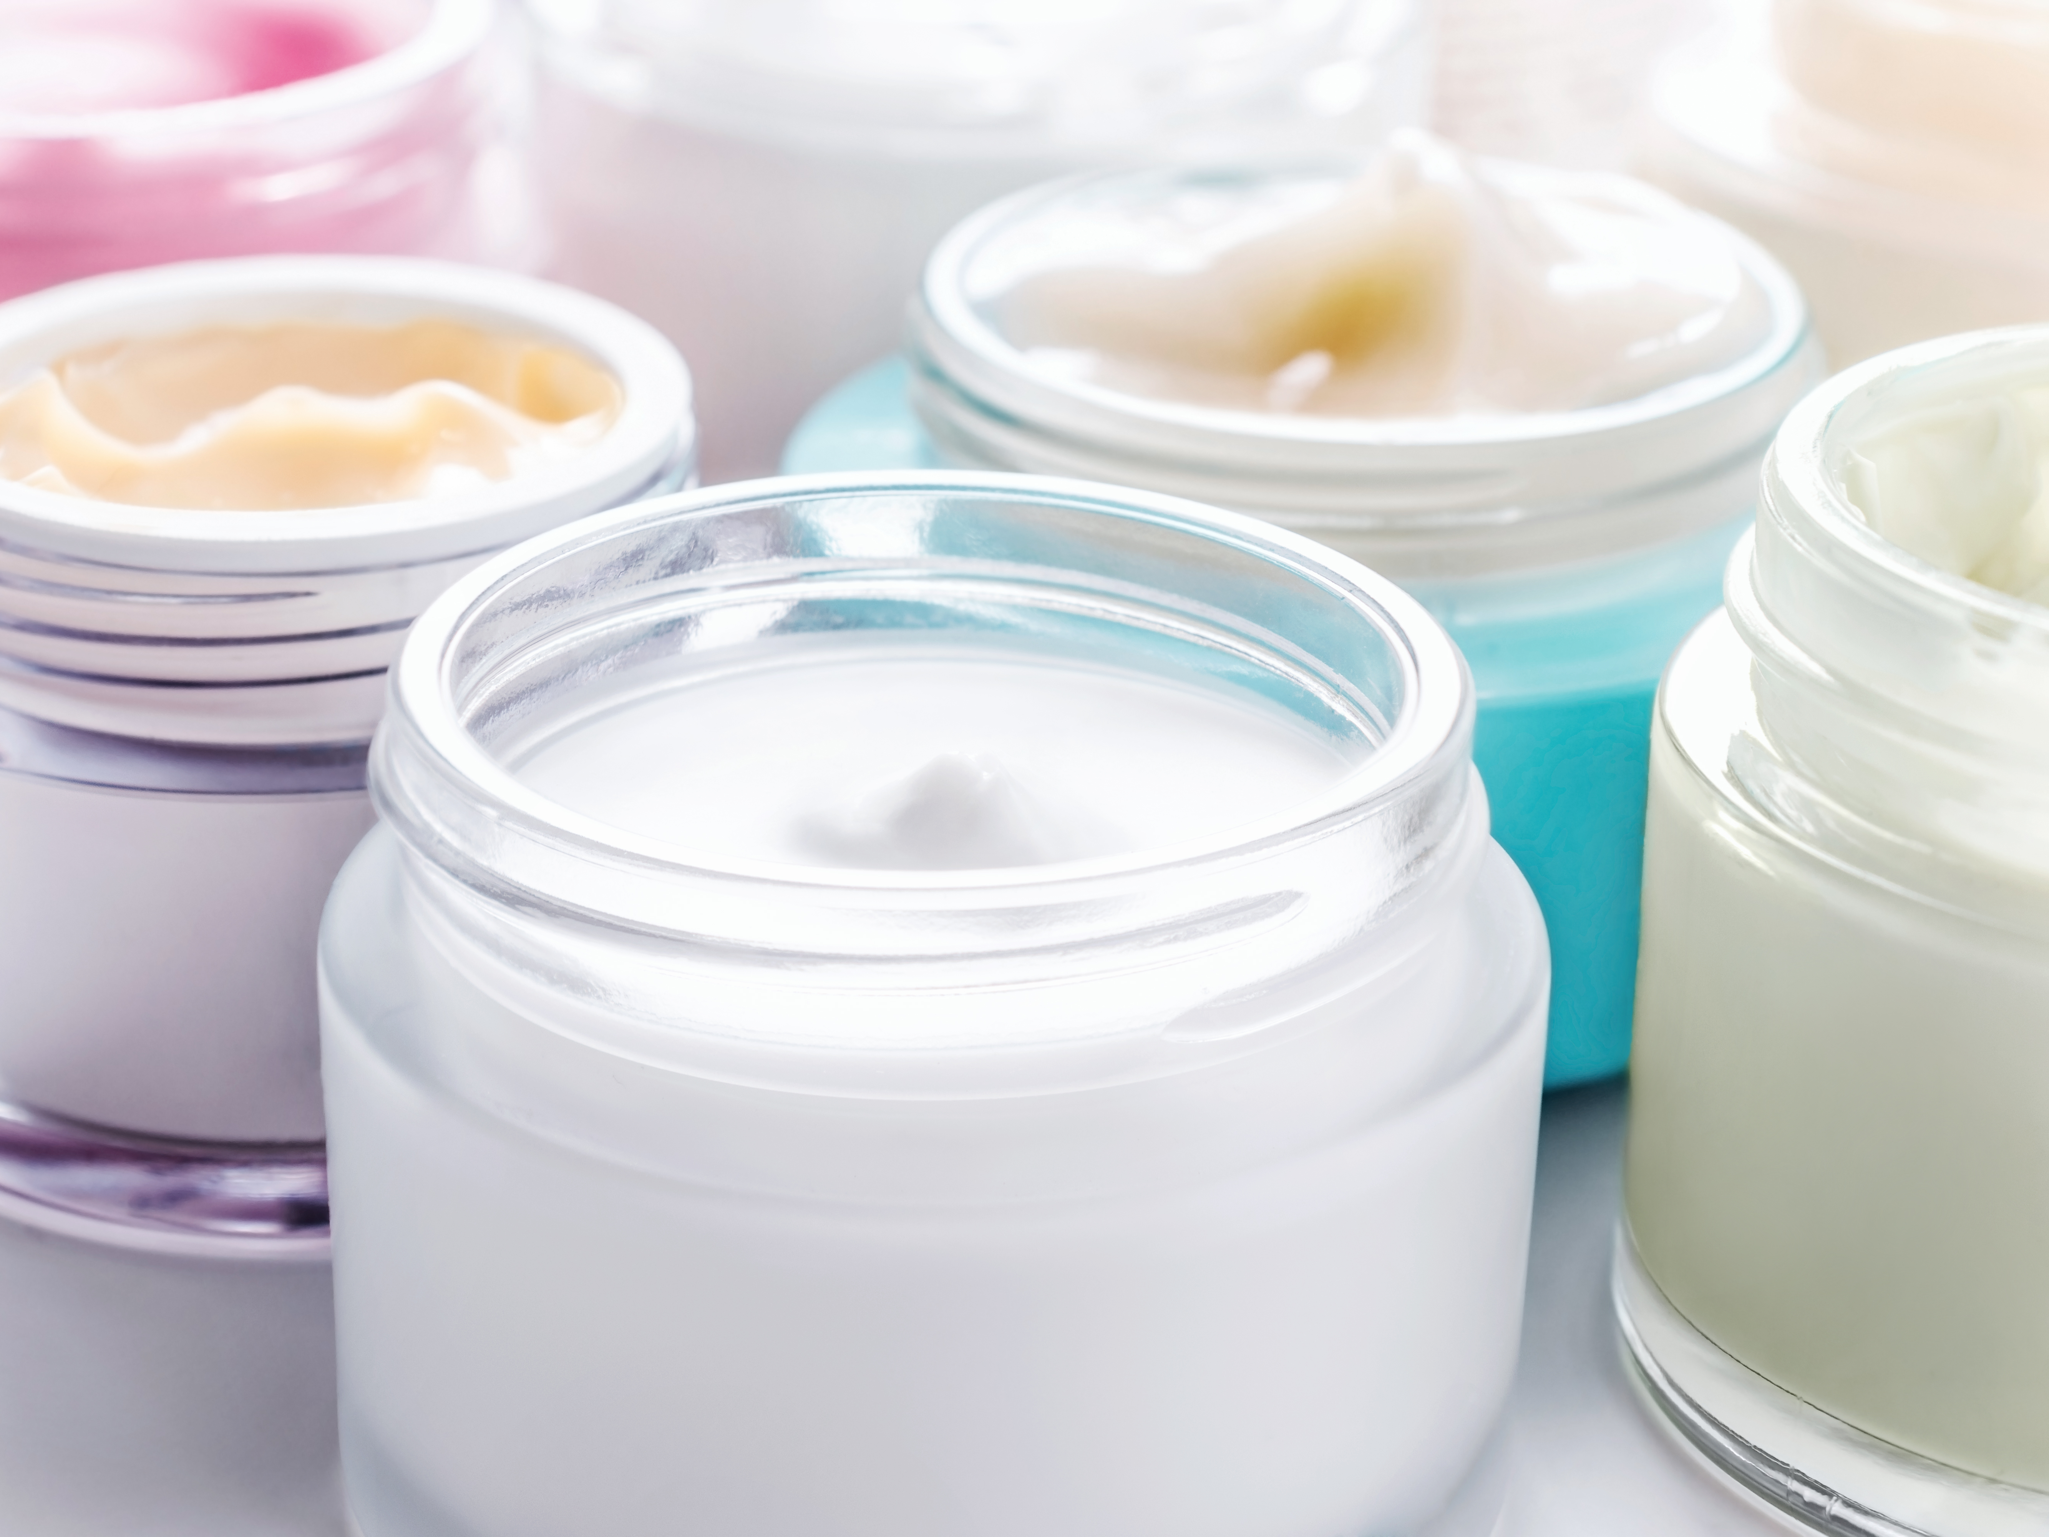
What is the pH of human skin?
Average = pH 5
The optimal range of pH for products applied to the skin is around pH4 to pH6.
If skin is kept outside this range, the natural oils in our skin are stripped causing redness, itchiness, inflammation and an increased risk of skin infection.
Notes:
Prompt: ask students if they follow a skincare routine. Ask those who do, why they wouldn’t recommend using hand soap to wash your face.

Slide 2


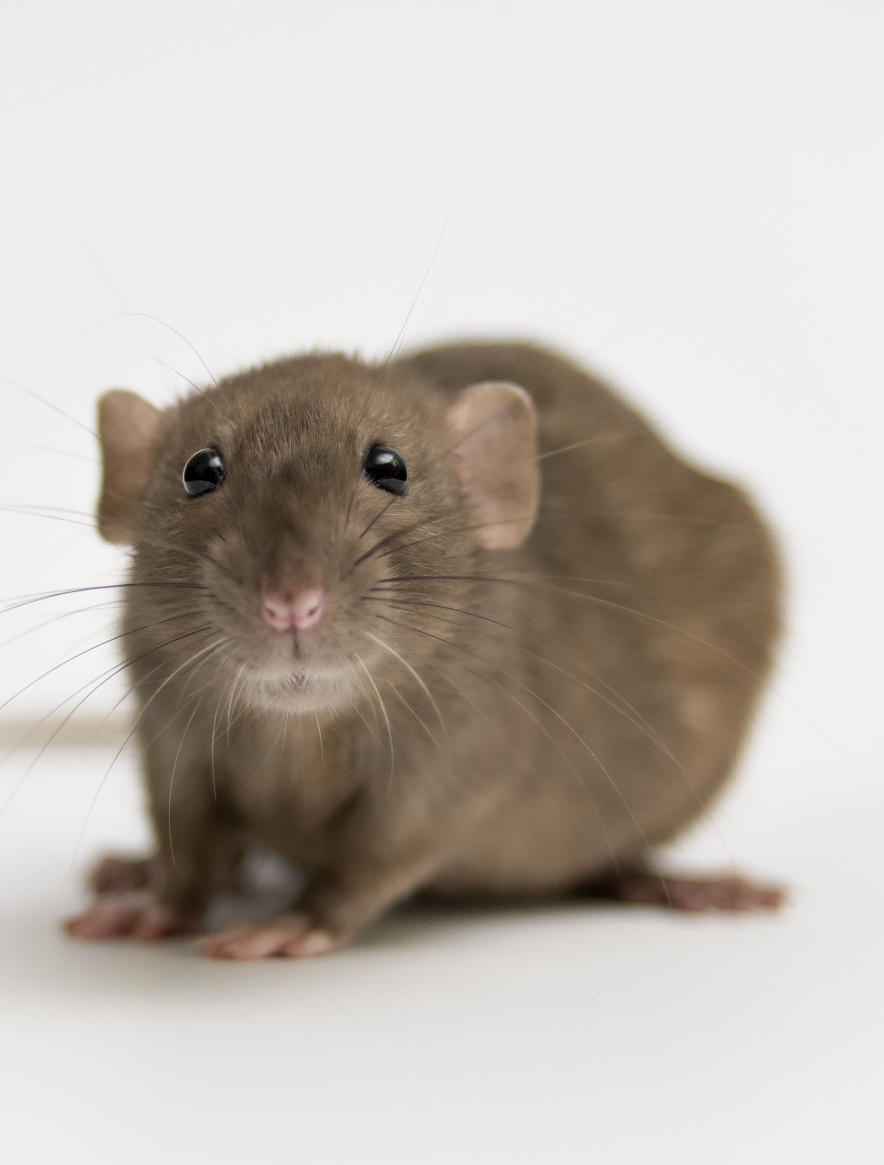
The optimal range of pH for products applied to human skin is around pH4 to pH6
Dog skin is slightly alkali at pH 7.5 so they require their own dog shampoo within the range of pH7 to pH8
Rat skin is close to neutral at around pH 6.5, with a suitable range of pH5 to pH7
Notes:
Dogs – discuss dog shampoo
Rats – discuss rat/small mammal shampoo

Slide 3
You will test the 3 potential new cosmetics to see if they are safe for human use.
Hazards and risk minimisation:
Solutions may cause irritation if contact with skin or eyes occurs. Take care not to touch the solutions and wear safety goggles. If contact with skin or eyes does occur, rinse with water and tell an adult.
To minimise risk of glassware breakages and/or spillages, please leave the beakers in the centre of the table.
1. Get into groups of 2 or 3.
2. Place an indicator strip into one of the substances.
3. Hold the indicator strip next to the chart to determine the pH.
4. Make a note of the colour and pH value in the results table.
5. Repeat for the other two substances.
6. Using the “essential background information” above, decide if each of these substances would be suitable for rats, dogs and humans and make a note of this in the table below.

Slide 4
Substance | Colour of indicator | pH | Suitable for rats? | Suitable for dogs? | Suitable for humans?
A
B
C
If you were to test these substances on dogs or rats, would the results be relevant to humans?
Explain your answer.
Notes:
Substance A = pH 4
Substance B = pH 6
Substance C = pH 7

Slide 5
Substance | Colour of indicator | pH | Suitable for rats? | Suitable for dogs? | Suitable for humans?
A |  | 4 | no | no | yes
B |  | 6 | yes | no | yes
C |  | 7 | yes | yes | no
If you were to test these substances on dogs or rats, would the results be relevant to humans?
Explain your answer.
No.
Substance A is unsuitable for rats and dogs but is suitable for humans. Substance B is suitable for rats but not dogs – why one is right?
Substance C is suitable for animals but not humans.
This is because animals are different to us.
Of course, this is a very basic test to show one of the many differences between humans and other animals.
Let’s have a look at some real-life examples of safety tests…
Notes:
Substance A = pH 4
Substance B = pH 6
Substance C = pH 7

Slide 6


Slide 7
Think, pair, share…
Do you think it is ethical to test on animals?
Do you think it is good science to test on animals?

