Slide 1
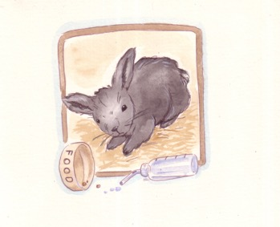
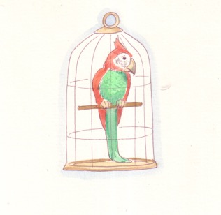
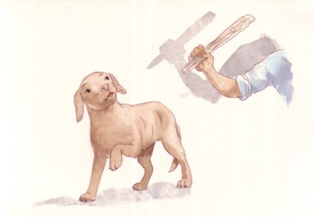
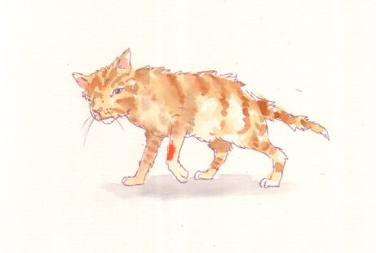
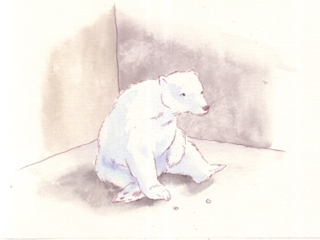
Five freedoms
for animals
Freedom from hunger and thirst
Freedom from discomfort
Freedom from fear and distress
Freedom from pain,
injury, or disease
Freedom to express normal behaviour

