Slide 1
Dilemma:
a difficult choice between
two or more options

Slide 2
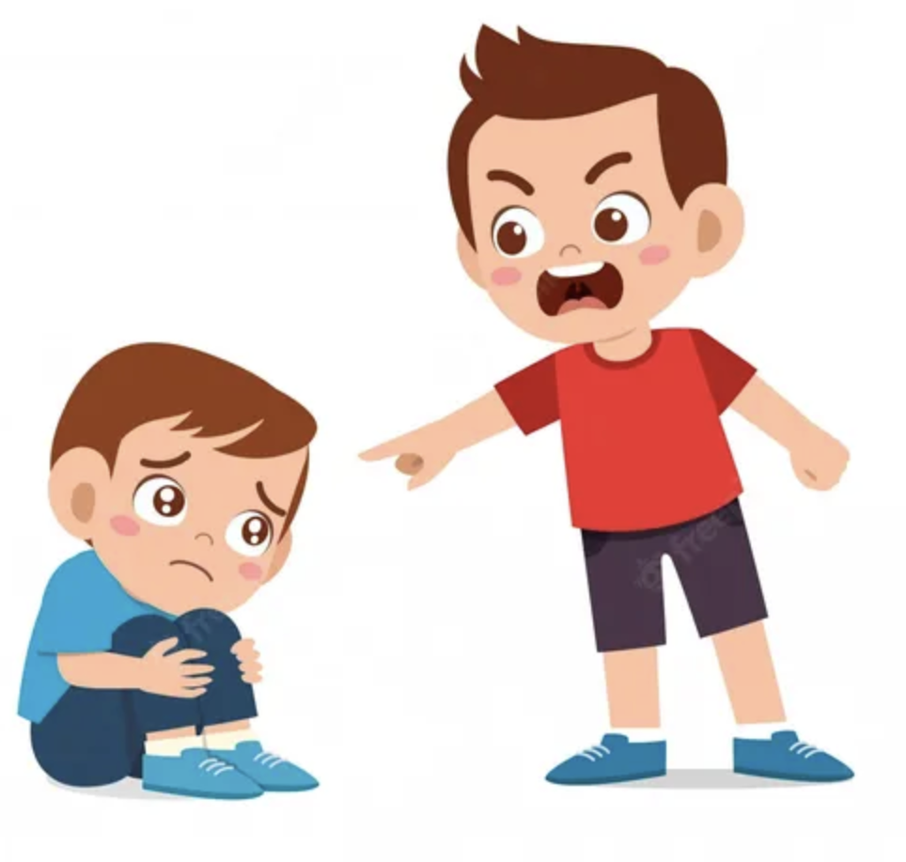
You see someone
being mean
to a smaller
child.

Slide 3

Do you step in,
tell a teacher
or walk
away?

